Slide 1
Prediction Customer Lifetime Value Using Pareto NBD
Final Project by Michael Jacob E J

Slide 2


Customer Lifetime Value
Brazillian E-commerce Olist
Business Background
The olist store is a sales model in which your products are displayed and marketed within olist on the largest marketplaces in Brazil and other relevant e-commerces.
The olist store understand that customers are their most important asset and that it is imperative to estimate the potential value of this asset.
Currently, there is an escalating demand for web services and web applications, along with continuous growth in worldwide commercial application. the olist store realize that they must be able to measure the value of their web customers, i.e. the expected profit that will be derived from the relationship with web customers from the present until a specified period in the future.
So to solve this problem issues the olist store need The ability to accurately predict value of a company’s customers that has a large impact to achieve long-term gain.

Slide 3





Customer Lifetime Value
Brazillian E-commerce Olist
Proposed Solution
Problem Statement
Objective
which customers have the highest spend probability in next 365-days?
What is your action and recomenddation for customer churn?
which customers have the lowest spend probability in next 365-days?
etc
Distinguish active customers from inactive customers.
Generate transaction forecasts for individual customers.
Predict the purchase volume of the entire customer base.
Distinguish active customers from inactive customers.
Generate transaction forecasts for individual customers.
Predict the purchase volume of the entire customer base.
use machine learning to know value of transactions made by a customer with your business over his entire lifetime. Here the lifetime means the time period till your customer purchases with you before moving to your competitors
Business Benefit
companies can take the short term risks necessary to achieve long-term gain.
Marketing managers can develop different offers for different customers, based on the estimated contribution of such customers in the future.
Stock exchange analysts can use the company’s customer value in order to evaluate its worth to potential investors.
Customer value can serve as the basis for decisions regarding new campaigns, allocation of retention vs. acquisitions budgets, etc.

Slide 4

Customer Lifetime Value
Brazillian E-commerce Olist
Data Schema

Slide 5
Customer Lifetime Value
Brazillian E-commerce Olist
Data Understanding
The dataset has information of 100k orders from 2016 to 2018
Source Data:https://www.kaggle.com/olistbr/brazilian-ecommerce
The dataset has 11 column and 98665 rows
Just merger 3 csv for predicting customer lifetime value
Data dictionary:
Order id : unique identifier of the order
Customer id : key to the customer dataset. Each order has a unique customer_id.
Order purchase time : Shows the purchase timestamp.
Customer unique id : unique identifier of a customer.
Customer city : customer city name
Oder item id : sequential number identifying number of items included in the same order.
Product id : product unique identifier
Seller id : seller unique identifier
Shipping limit date : Shows the seller shipping limit date for handling the order over to the logistic partner.
Price : item price
Freight value : item freight value item (if an order has more than one item the freight value is splitted between items)

Slide 6
Customer Lifetime Value
Brazillian E-commerce Olist
Data Preparation
Python version 3.7.12
packages : pandas, numpy, lifetimes, seaborns, sklearn, matplotlib
Data Cleansing
Remove duplicate data
Remove unneeded columns to predict customer lifetime value
Change the data type to the appropriate in each column

Slide 7
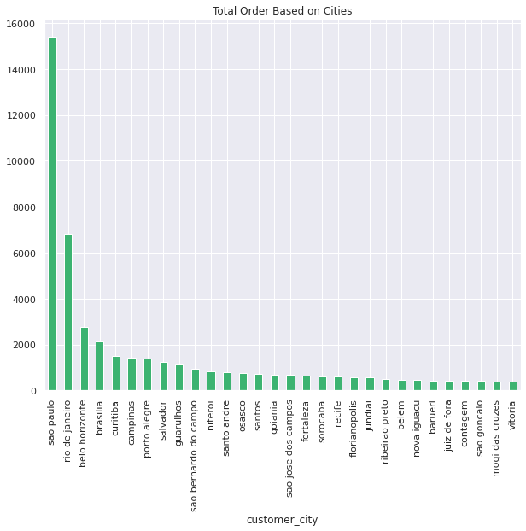
Customer Lifetime Value
Brazillian E-commerce Olist
Exploratory Data Anaylsis (EDA)
5 city with the best order are sao paulo,rio de janeiro,belo horizonte,brasilia,curitiba.

Slide 8
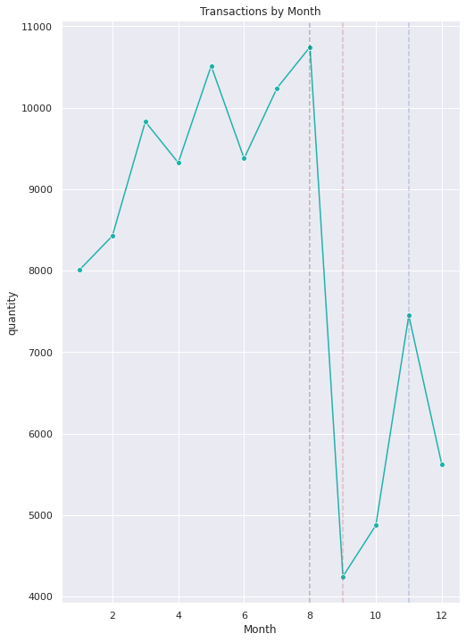
Customer Lifetime Value
Brazillian E-commerce Olist
Exploratory Data Anaylsis (EDA)
Most Transactions happened in the month of August which is evident due to festive seasons.

Slide 9
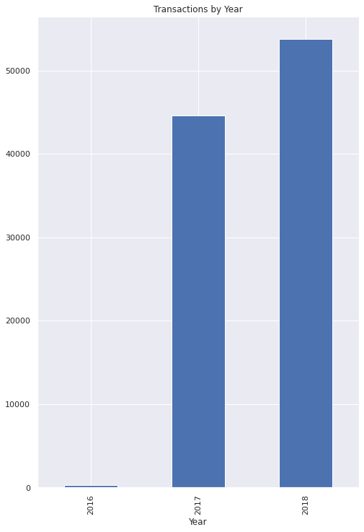
Customer Lifetime Value
Brazillian E-commerce Olist
Exploratory Data Anaylsis (EDA)
2018 is the year in which we have the most transactions followed by the 2017 and 2016

Slide 10
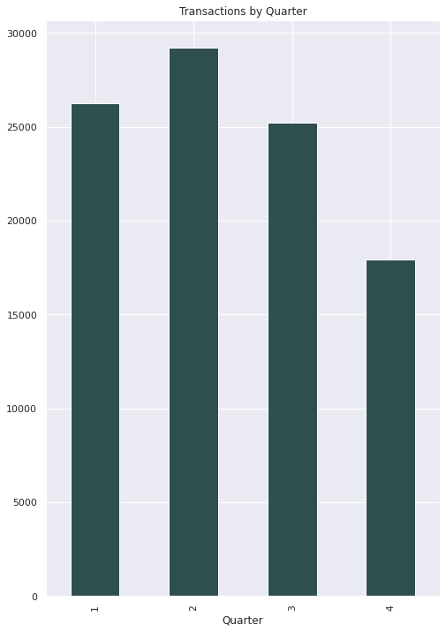
Customer Lifetime Value
Brazillian E-commerce Olist
Exploratory Data Anaylsis (EDA)
Q2 being the highest when it comes transactions.

Slide 11
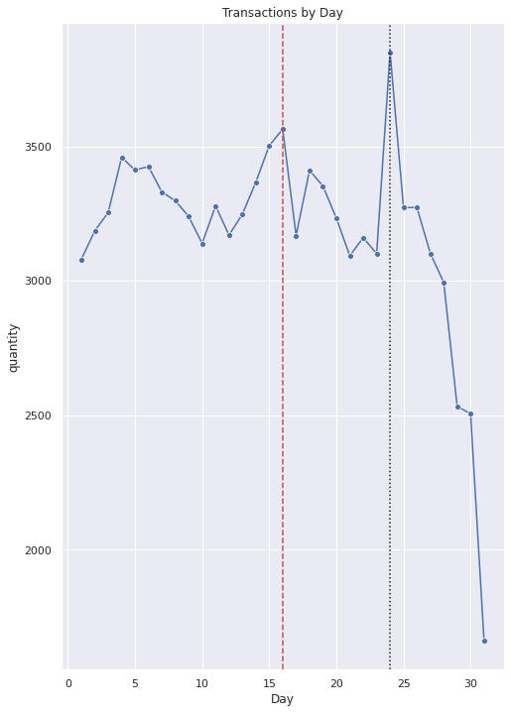
Customer Lifetime Value
Brazillian E-commerce Olist
Exploratory Data Anaylsis (EDA)
It also observed that in the end of the 1st week and starting of the 3rd week, people tends to buy more.

Slide 12
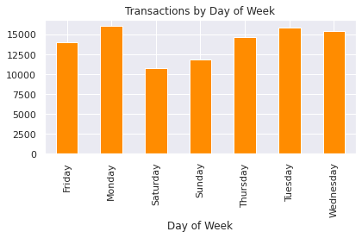
Customer Lifetime Value
Brazillian E-commerce Olist
Exploratory Data Anaylsis (EDA)
People loves to shop on monday followed by Tuesday and Wednesday.

Slide 13
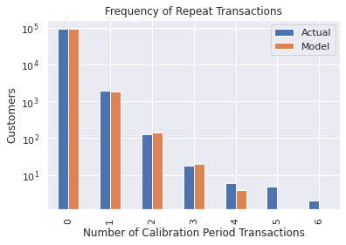
Customer Lifetime Value
Brazillian E-commerce Olist
Pareto Nbd Modelling
We can see that our actual data and our simulated data line up well. The model is fairly representative of the real data up until seven repeat transactions. There are few customers who make more purchases.

Slide 14
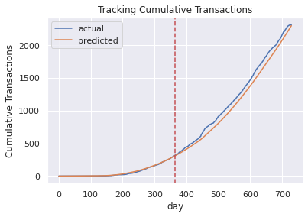
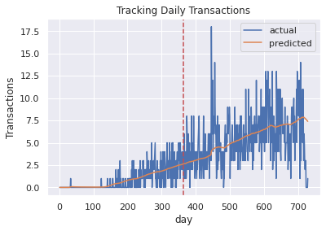
Customer Lifetime Value
Brazillian E-commerce Olist
Pareto Nbd Modelling
The red line represents the boundary between the calibration period on the left and the holdout period on the right. As you can see, the Pareto/NBD model is good at predicting cumulative transactions.
This plot shows that the model does a decent job capturing general trends in the data.

Slide 15
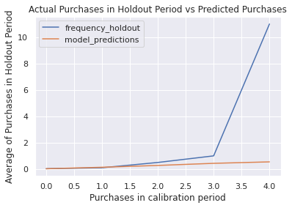
Customer Lifetime Value
Brazillian E-commerce Olist
Pareto/ Negative Binom Distribution Modelling
The model performs well up to three calibration period purchases, but diverges from the holdout data because of the distribution of the data.

Slide 16
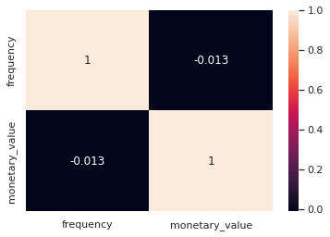
Customer Lifetime Value
Brazillian E-commerce Olist
Gamma Distribution Modelling
The model we are going to use to estimate the CLV for our data is called the Gamma-Gamma submodel, which relies upon an important assumption.
The Gamma-Gamma submodel assumes that there is no relationship between the monetary value and the purchase frequency. In practice we need to check whether the Pearson correlation between the two vectors is close to 0 in order to use this model.

Slide 17
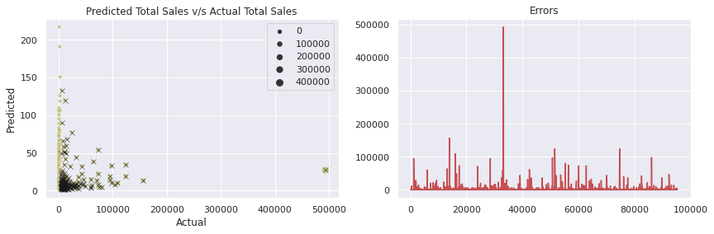
Customer Lifetime Value
Brazillian E-commerce Olist
Pareto NBD +Gamma Distribution Modelling
Actual Avg Sales: 113.26364540367545
Predicted Avg Sales: 113.08382919908112
Mean Sqaured Error: 2940.122843020948
Root Mean Squared Error: 54.222899618343426
Avg Sales Error: 0.17981620459433145

Slide 18
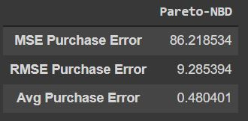
Customer Lifetime Value
Brazillian E-commerce Olist
Purchase Prediction Result Summary

Slide 19
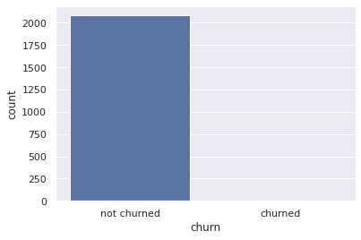

Customer Lifetime Value
Brazillian E-commerce Olist
Churn Risk From Pareto NBD + Gamma Distribution Modelling

Slide 20
Customer Lifetime Value
Brazillian E-commerce Olist
Action and Recommendation
not churned:
Reward Customers
Serve them additional benefits to ensure that they remain loyal customers(VIP).
high risk:
Identify what happens when a customer defects.
Set up alerts to get more details.
Know the ideal customer journey.
Don’t be afraid of the exit interview.
Treat former customers like friends, not enemies.
churned:
Give better service
Pay attention to complaints

